Slide 1
CLT (Classic Learning Test)
Fall 2025

Slide 2
Usage
The CLT is approved for use as a concordant/comparative option for students to meet the grade 10 ELA and Algebra EOC graduation requirement
Only for students who entered Grade 9 in 2020-2021 and beyond
The CLT is a 3-part, computer based test which takes roughly 2 hours (with admin and script reading
Students must take the entire test
May superscore

Slide 3
Scores for Mastery
Students in Cohorts 20-21 and beyond
  Verbal Reasoning + Grammar/Writing ≥39 Meets Grade 10 ELA
  Quantitative Reasoning ≥ 14 Meets Algebra 1 EOC
  These are the new scores that went into effect on 8/19/2025.
Students who entered grade 9 in 2020-2021 through 2022-2023
  Verbal Reasoning + Grammar/Writing ≥36 Meets Grade 10 ELA
  Quantitative Reasoning ≥ 11 Meets Algebra 1 EOC

Slide 4
Test Security
Generally, we will follow the same policies and procedures that we do for state testing.
The CLT now uses the Respondus Lock Down browser. This is a required download.
One proctor is required for every 20 students.
Students may not advance to the next section until directed by the test administrator, and may not ever return to a previous section.
Students that leave campus before finishing may not complete the test on a subsequent day, even if they left due to illness.

Slide 5
Test Security
Prohibited Items
Cell phones
Calculators
Smart watches/Smart glasses
Books
Resource/reference material of any kind
Snacks (only allowed during break)
Invalidations are entered by the Test Administrator into the Administration Report after testing.

Slide 6
Test Administration Resources
School Administrator Guide
Instructions for Importing Students
Test Administration Manual & Checklist
Schedule & Script (now you should use the CLT script since the l/d browser is active)
Test Day Help Guide
Accommodations Info
Accommodations Documentation Guide
Evaluation Services Website www.escambiaschools.org/eval
Notes:
Modified script

Slide 7
Test Setup
Student Admission/General Announcements (10 minutes)
Administrative materials (10 minutes)
Verbal Reasoning (40 minutes)
  40 questions of textual comprehension and textual analysis
Grammar/Writing (35 minutes)
  40 questions of grammatical editing and improvement
Break (10 minutes)
Quantitative Reasoning (45 minutes)
  40 questions of logic and mathematics
Closing Announcements & Student Surveys (5 minutes)
Administration Report & Proctor Survey (5 minutes)

Slide 8
School Registration
The CLT must be managed at the school level. Eval Services cannot handle school registrations, importing students or accommodations at the district level.
Each school will need to designate a School Administrator for the CLT to handle these tasks.
Your school administrator will use the registration form linked in the Test Administration Manual to register your school.
Registration for a test must occur prior to importing students for that test.

Slide 9
Registration
Schools must have a registered account with CLT
Go to www.cltexam.com
  At the top, click on “For Schools”
  Scroll down the select the “CLT for Florida Schools” button
  Select “Order tests”
  Select “Order Online tests”
  Complete the registration form
If you have an existing account, you can log in and order for a certain date

Slide 10
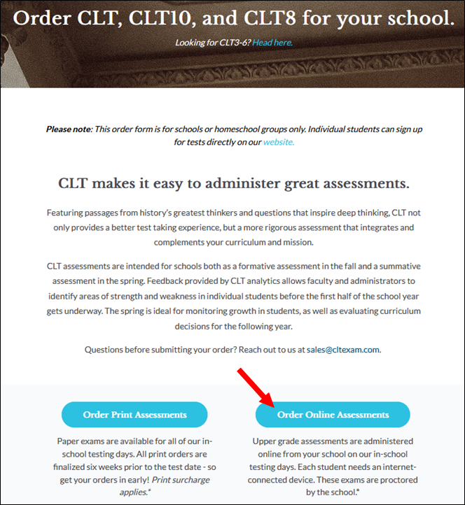
School Registration Form

Slide 11
Student Import
Importing refers to getting your students’ information into your school administrator portal by uploading your student roster. Importing must be done after you have completed school registration.
The Student Registration File includes student’s First Name, Last Name, Username (email), Password (random).
Student Import Instructions & Video are in the manual.
Let us know if you need help with your Student Registration File.
**Make sure you have the CORRECT student email address in your import file and use FOCUS first name, not a nickname

Slide 12
Login Tickets
You will need to create, print and cut out your login tickets.
The student’s username is their school email address. (@ecsd.me)
You will need to set the passwords for your students, but students are able to reset their passwords by clicking the Forgot Password button on the login page.
Let us know if you need help with your login tickets.
The easiest way is to perform a mail merge using MS Word.

Slide 13
Accommodations
CLT does allow students with an IEP/504 or ELL plan with a current plan to use testing accommodations
You will need to have either your test coordinator or ESE personnel have access to the CLT Accommodations Portal -
Obtain signed parental consent in the Consent Form for Releasing Accommodations Documentation
CLT offers extended time (up to 100% same day), text to speech, screen reader, 4 function calculator, bilingual word-to-word dictionary, human reader, and various medical accommodations
See the Accommodations page here: CLT Accommodations

Slide 14
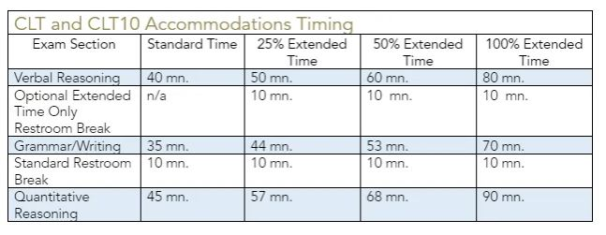
Accommodations
Timing for extended time
Recommended to test in separate room with a separate proctor

Slide 15
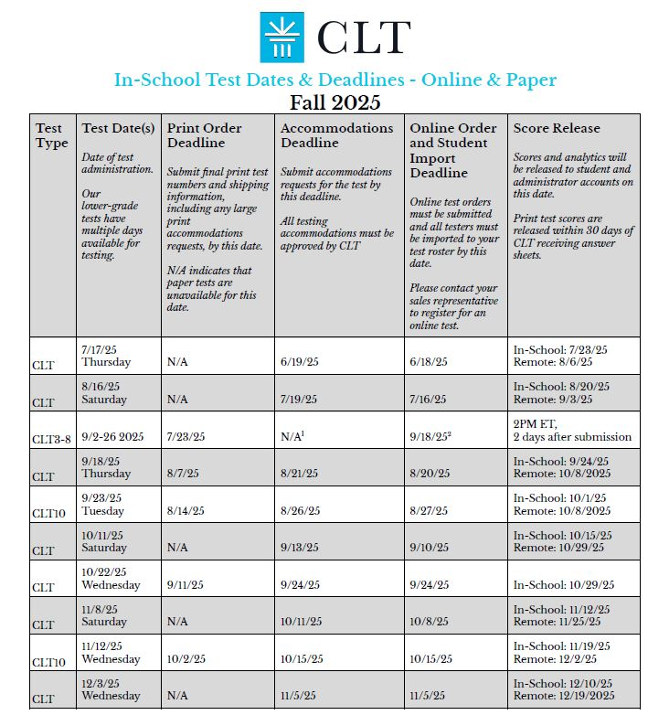
CLT Dates/Deadlines
Fall 2025 Dates:
9/18, 10/22, 11/12, 12/3

Slide 16
Before Testing
You are responsible for training all test administrators and proctors before testing.
* Parent letters must be sent out to all parents of students that you are planning to test.
Practice tests are optional. Each student can take up to 3 practice tests. Practice tests can be given at school or at home.
Print or share the scripts for test administrators. Remind them to stick to the script.
Prepare your Login Tickets.
Prepare scratch paper and pencils for each classroom.
A week before the test you (School Administrator) will receive an email with your Test Access Code. Keep the code secure until test day.

Slide 17
Proctor Requirements
Proctors must be at least 21 years old.
Proctors may NOT be related to the students they are proctoring.
One proctor should monitor no more than 20 students. Schools may assign smaller cohorts if desired.
Proctors must be able to see all students’ screens and desks, remain within a reasonable distance from each student, and maintain spacing according to the guidelines (see spacing requirements).

Slide 18
On Test Day
Distribute test materials to test administrators.
  Test Access Codes (emailed to school admin a week before the test)
Access codes will be labeled as follows:
  Test Access Code - to begin the test
  Section 2 Code - to begin Section 2
  Section 3 Code - to begin Section 3
Scripts
Login tickets
Scratch paper and pencils
Notes:
Test Access Code: Emailed to school admin the week before the test. Do not give the Test Access Code to students or write it anywhere until it is time for students to begin the exam. Take any necessary steps to ensure that no students are able to see the code before the appropriate time.

Slide 19
On Test Day
Prepare testing rooms (cover/remove visual aids).
Student spacing guidelines are recommended, not required.
Display the Test Day Signs on classroom doors.

Slide 20
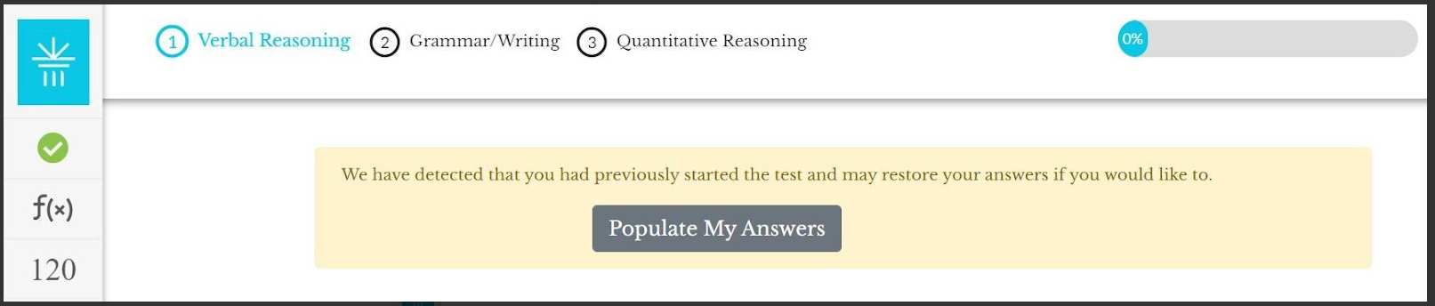

On Test Day
If a student is disconnected during the test, log back in and resume testing. A button should appear labeled "Populate My Answers" at the top of the screen (see image below). If the student doesn't see this, have the student refresh the page. Once the button appears, have the student click it. Have the student check that all answers were repopulated.
Tech support is available via online chat. Navigate to www.cltexam.com/contact and click on the chat icon in lower right hand corner.

Slide 21
On Test Day
In-Progress Dashboard for Test Managers
  A new dashboard feature allows test managers to monitor the real-time status of student submissions during the test.
  You can now view which students are still testing and which have submitted their exams.
  This update also simplifies the process for deactivating student registrations.
  Please refresh the dashboard to track testing status.
Important Guidelines:
  Any student who is absent on test day must be deactivated.
  If a student still appears as “in-progress” after being told to submit, they must be deactivated. A test anomaly report must then be submitted by the proctor or test manager.

Slide 22
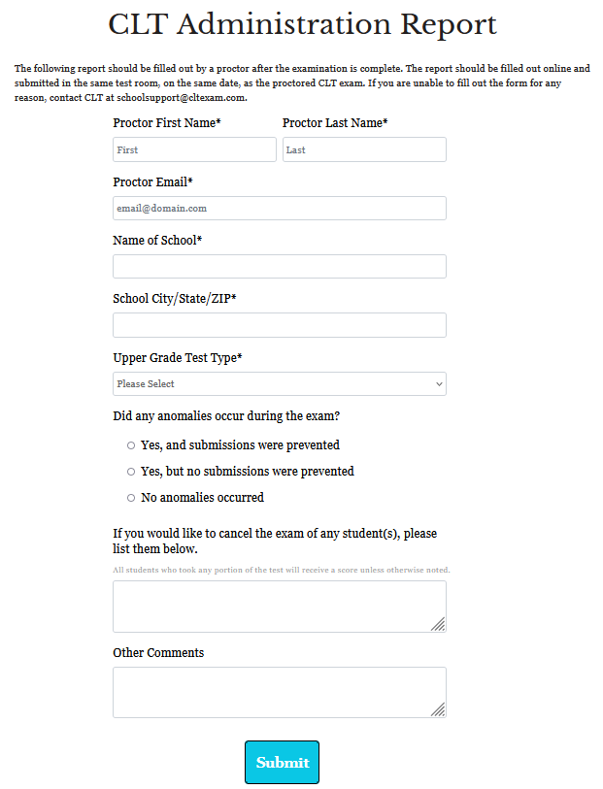
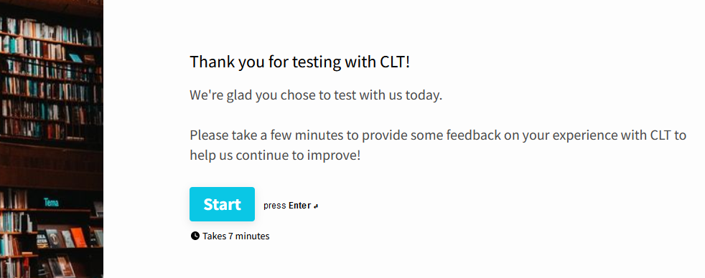
After Testing (Test Administrators)
Dismiss students
Collect and securely dispose of scratch paper
Complete the Administration Report
Complete the Proctor Survey

Slide 23
After Testing (School Administrators)
You will receive an email about a week after testing that your results are available.
Email Scott Dodson (sdodson@ecsdfl.us) once you have received your score email
You no longer have to download scores and put them into Google drive

Slide 24
After Testing (Students)
Students can view their own scores by logging in to their CLT accounts.
*36/39 out of 80 required to meet the ELA requirement.
*11/14 out of 40 required to meet the Algebra requirement.
* Dependent on year entered Grade 9 (See slide 3 or “Graduation Requirements for Florida’s Statewide Assessments”)
Please have students review wrong answers/questions as CLT will reuse questions in subsequent iterations of the test

Slide 25
Resources
CLT Manual
Proctor Guide
Lock Down Browser
Test Room Set Up
CLT In School Script

Slide 26
Questions
Heather Rykard, TSA
Test Administration, Accommodations
hrykard@ecsdfl.us 850-469-5387
Scott Dodson, Specialist
Score Entry
sdodson@ecsdfl.us, 850-469-5389

